Slide 1

Interpersonal Skills

Slide 2

Course Objective
To set clear guidelines for effective communication and to consider the role of good interpersonal skills in the multicultural workplace by understanding:
❑ different behavioral styles and learn to modify your behavior to achieve best
❑ how to give and receive constructive feedback as a way to build better relationships
results
to demonstrate assertive behavior
❑ how to stay present 'in the moment', 'listen for intent', and influence your listener
❑ how to communicate effectively when the stakes are high and you need to neutralize arguments
positively
effectively
❑
To create individual action plans for ongoing personal development by making use of all of the above skills to ensure effective teamwork

Slide 3

Course Content
➢
Interpersonal Skills
▪
Introduction (Interaction & Person)
▪
Importance of Interpersonal Skills
▪ Communication in Interpersonal Skills
➢
Tools in Interpersonal Skills
▪ Verbal communication ▪Problem-solving ▪ Non-verbal communication ▪ Decision-making ▪ Listening skills ▪ Assertiveness
▪
Negotiation
➢
Emotional Quotient (EQ) with Interpersonal Skills
▪
Integrating EQ to Interpersonal Skills to perform better at your workplace.
▪ How can you develop your EQ skills to perform better at your workplace position?
➢
Strategic Leadership
▪
Applying EQ to Address Your Workplace Challenges

Slide 4
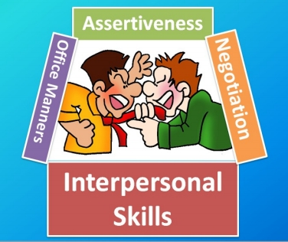
Importance of Interpersonal Skills
Employers will notice the presence or absence of these skills immediately during an interview, and they can impact long- term advancement opportunities.
These skills are also important
outside of the work
environment: life skills training
can be “critical in enhancing the
self-esteem of participants,
providing them the tools
necessary to overcome their
fear of independence and
allowing them to experience
their own definition of success”
(Tucker, 2005).

Slide 5

Communication in Interpersonal Skills Words are powerful tools of communication. Indeed, word choice can easily influence the thoughts, attitudes, and behavior of the people listening to us.
Similarly, proper attention to the language of others can give us insight to what it is that they are really saying, helping us to
respond appropriately and
effectively.

Slide 6
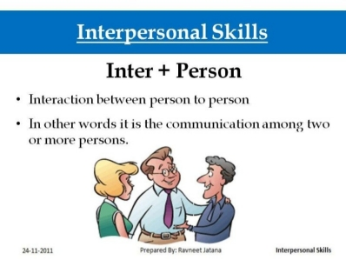
Tools in Interpersonal Skills Interpersonal skills are the tools people use to interact and communicate with individuals in an organizational environment. There are seven main areas of interpersonal communication.
The seven areas are:
•Verbal communication
•Non-verbal communication
•Listening skills
•Negotiation
•Problem-solving
•Decision-making
•Assertiveness

Slide 7
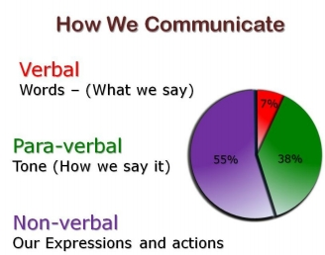
Tools in Interpersonal Skills
1.Verbal Communication
Verbal communication is how and what words are used to communicate with individuals. It is the ability to communicate through words with the correct tone and manner.
Fred's initial week with Intestinal Distress Taco revealed that he was not capable of good verbal communication. He mumbled orders and then screamed when employees did anything wrong.
Most employees grew to dread working with Fred because they could not understand his directions. He also was not a good non-verbal communicator as well.

Slide 8
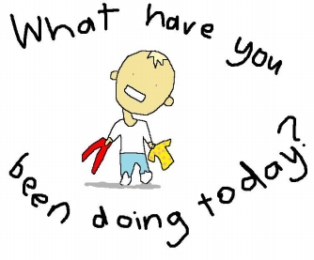
1.Verbal Communication
Asking questions
If communication is the exchange of information between two or more people, then questions are a way to elicit the specific information that you are looking for.
But more so, well ‐crafted
questions make for an engaging
conversation. It can establish
rapport, spark interest and
curiosity others, break new
grounds, and communicate your
own sincerity in learning what
people around you has to say.
Here are some tips in asking questions effectively:

Slide 9
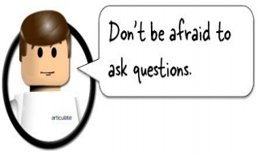
1.Verbal Communication
Ask!
First of all, don’t be afraid to ask questions! Sometimes shyness, concern over making a faux pas, or fear of being perceived as a busybody, can keep us from asking questions.
While some subject matters are not appropriate conversation pieces in the early stages of a conversation, there’s nothing wrong in asking questions.
Start with your inherent curiosity about people, if you’re genuinely interested in a person, you won’t run out of things to ask.

Slide 10

1.Verbal Communication
Asking questions
The two kind of questions.
There are two kinds of questions based on the scope of
the answers they elicit:
Closed & Open questions
o Closed questions are questions answerable by yes or no. Example: “Are you happy with today’s presentation?”
o Open questions, on the other hand, are questions that require a qualified response .

Slide 11

1.Verbal Communication
Open questions – the 5W & 1H
Open questions are usually preceded by who, when, where, what, why, and how.
Example:
“What is it about today’s presentation that you find most engaging?”
o Open questions are more effective than closed questions
because they evoke thoughtful consideration of the subject and creative thinking.

Slide 12
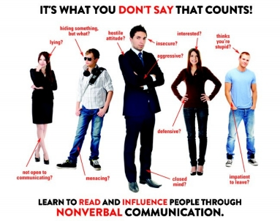
Tools in Interpersonal Skills
2.Non-Verbal Communication (NVC)
Another type of interpersonal skill is non-verbal communication, which consists of facial expressions, body language and hand gestures.
Non Verbal Communication
can be Positive as well as
Negative.
Negative Non Verbal
Communication consisted
of frowns and angry stares.

Slide 13
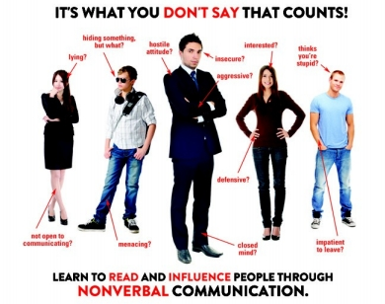
2.Non-Verbal Communication (NVC)
Positive Non Verbal Commnication always has a smile on the face and uses hands to further explain complicated directions.
Speak clearly and animate
with positive non-verbal
communication.
Two way communication is
essential when developing
a set of excellent
interpersonal skills.

Slide 14
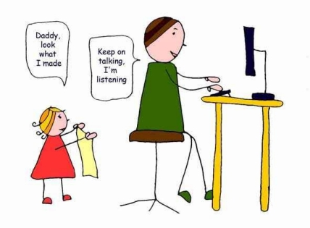
Tools in Interpersonal Skills
3.Listening skills
The ability to hear attentively and process information correctly.
A very ineffective listener
do not pay attention
when they are told.
They have the tendency
to ignore important
pieces of other’s
communication.

Slide 15
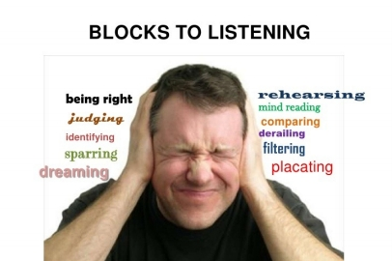
3.Listening skills
Listening and Hearing: They are not the Same
Most people can hear, but few can really listen.
Hearing is simply the process of perceiving sounds within our environment.
The best way to illustrate hearing is through the
biological processes
involved in sensory
perception.
Specifically: Our ears pick up sound waves around us, sends signals to our brain, and our brain in turn tells us what the sound is and where it is coming from.

Slide 16
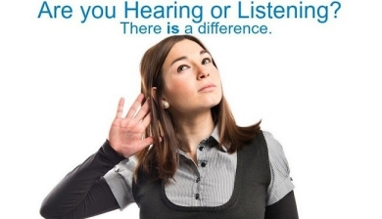
3.Listening skills
Listening and Hearing: They are not the Same
Listening, on the other hand, goes beyond simply picking up stimuli around us, and identifying what these stimuli are.
Listening involves the extra
steps of really
understanding what we
heard, and giving it
deliberate attention and
thoughtful consideration.
It may be said that listening involves a more active participation from a person than simply hearing

Slide 17

3.Listening skills
Listening and Hearing: They are not the Same
An example to illustrate the difference between hearing and listening:
A secretary presented her boss the schedule for the next day. She told the boss that she has a packed day for tomorrow, and that she only has an hour of break time for the whole afternoon. The boss, busy studying a report, merely nodded to the secretary, and motioned for her to place the schedule on her desk. The boss continued to study the report as if there were no interruption.
In this case, the boss simply heard what the secretary said; paid just enough attention to make an appropriate but non ‐committal reaction. If the boss had been listening, his reaction would have been different.

Slide 18
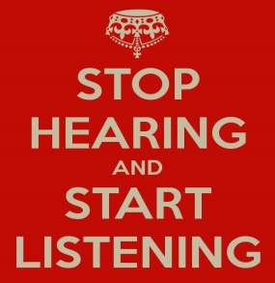
3.Listening skills
Listening and Hearing: They are not the Same Taking the extra step to move from hearing to listening
can enhance a person’s interpersonal relationships in many ways.
Listening promotes a more
accurate and deeper
understanding of a person’s
communication, helping a
responder to provide the most
appropriate response.
But more so, when you’re listening to a person, you communicate to them that you value not just what they are saying, but their presence as well.

Slide 19

Tools in Interpersonal Skills
4.Negotiation
Negotiation is the next type of interpersonal skill that is important to effective business communication. This term means having the ability to discuss and reach an agreement
in a professional manner.
Example
Violet excels in negotiation as the employees and customers are always complaining or asking for favors. She is good at listening and discussing situations and then coming up with a fair solution.
On the other hand, Fred ignores any request for discussions and rules with an iron fist. This has caused his employees to view him as unfair and undiplomatic, especially when it comes to solving problems.

Slide 20

Tools in Interpersonal Skills
5.Problem-Solving
The fifth type of interpersonal skill is problem-solving. This is a very important skill and the most complex part of the process is to look at each potential solution and carefully analyze it.
The ability to find a
solution to a problem
after considerable
thought to solved
numerous issues
without creating a new
problem

Slide 21

Tools in Interpersonal Skills
6.Decision Making
This is the most complex part of the problem solving that requires careful analysis of the outcome of actions and then selecting the best solution for implementation. It requires simulating each potential solution carefully.
We all have to make decisions all the time, from issues like what to have for lunch, right up to life- changing decisions like where and what to study, and who to marry .
Some people put off making decisions by endlessly searching for more information or getting other people to offer their recommendations. Others resort to decision-making by taking a vote, sticking a pin in a list or tossing a coin.

Slide 22
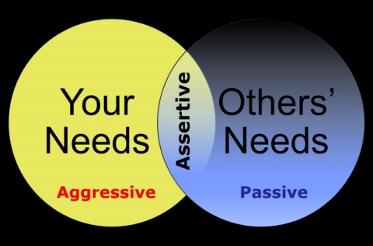
Tools in Interpersonal Skills
7. Assertiveness
is about being able to express yourself with confidence, without having to resort to passive, aggressive or manipulative behavior
It involves greater
self-awareness;
getting to know,
like, and be in
charge of the real
‘you’.

Slide 23

7. Assertiveness
Communicating with Power
Power in communication refers to the ability to influence, persuade, or make an impact. A powerful communication is associated with self ‐confidence, credibility, and effectiveness.
The following are some ways you can communicate with
power verbally:
•Stick to the point
•Don’t be too casual
•Emphasize key ideas
•Tailor‐fit your communication to your audience
•Connect

Slide 24
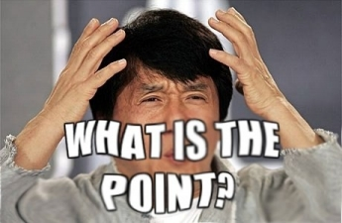
Communicating with Power
Stick to the point
Powerful communication is all about sticking to what is relevant to the discussion, and getting your message across in the shortest ‐‐‐ but most impact ‐laden ‐‐‐ way possible.
Get rid of fillers like
“uhm…”, “you know”, or
“actually” in your delivery,
and avoid off ‐topic
statements.
Just provide the bare bones ‐‐‐ the ideas your audience would be most interested in knowing, or the ones that promote your intentions best

Slide 25
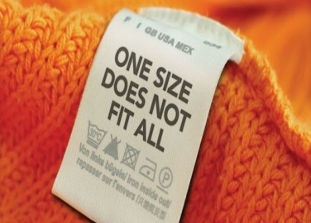
Communicating with Power
Tailor‐ fit your communication to your audience.
A powerful communication is one that connects with one’s audience.
In this case, minding the readiness, attention, age,
and educational level of
your audience is very important, so that you don’t overwhelm or underwhelm
them.
Social skills are primarily about flexibility; the better you can adjust to changes in your audience profile, the better off you’ll be.

Slide 26

Communicating with Power
Connect.
Power in communication is sometimes determined by the quality of your rapport with others.
You may need to “warm up” your
audience, make them
comfortable, and show them that
you sincerely want to talk with
them. The more others see you
as “one of them”, the better their
reception of anything that you
have to say will be.
Your non‐verbal communication can be a big help in connecting with others.

Slide 27
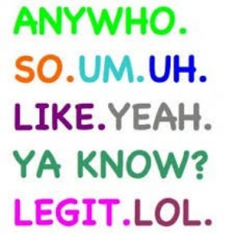
Communicating with Power
Don’t be too casual.
Note that phrasing appropriate when talking with friends is not necessarily appropriate for business ‐related meets.
The use of slang, street talk, and poor grammar can detract from your credibility, especially if you’re mingling with potential clients, employers, and Page
10 business partners.
Events that require you to come across as impressive may require the use of industry ‐specific jargon and a formal tone ‐‐‐ so adjust accordingly.

Slide 28

Emotional Quotient (EQ) with Interpersonal Skills Decades of leadership research suggest that “people skills” are crucial for leader effectiveness.
Integrating EQ Skills in
Interpersonal Skills allows
you to leverage EQ
competencies to enhance
performance and
productivity in your
organization.
The focus is on improving leaders Social Skills by integrating EQ skills with Interpersonal Skills

Slide 29
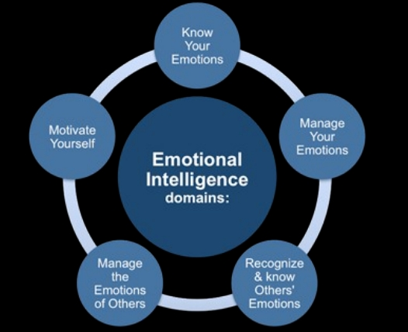
Emotional Quotient (EQ )
Emotional Quotient / Intelligence refers to a set of emotional and social skills and competencies that influence the way we perceive and express ourselves;
develop and maintain
social relationships; cope
with challenges; and use
the information in
emotions in effective and
meaningful ways.

Slide 30

How can you develop your EQ skills to perform better at your workplace position?
1. Take Initiative: Demonstrate responsibility and enthusiasm for your job by striving to go the extra mile .
Do tasks without being
asked by someone else.
Look around, This starts
by finishing work without
constant reminders from
your supervisor.
And if you are already in a leadership role, this means setting the example what needs to be done, and do it. Be the owner

Slide 31

How can you develop your EQ skills to perform better at your workplace position?
If a co-worker has a large project and you have some time on your hands, volunteer to help.
Further, you could seek
more challenging work
and strive to develop
your technical skills and
do it.
Be the Owner. This rarely goes unnoticed.

Slide 32
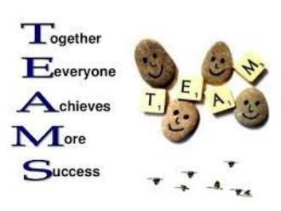
How can you develop your EQ skills to perform better at your workplace position? 2. Act as a team player: This means not only
being cooperative, but also displaying strong leadership skills when necessary.
Practice leading in small
group discussions by
asking your teammates
questions and bringing
quieter members into the
conversation.

Slide 33

How can you develop your EQ skills to perform better at your workplace position? 3. Be flexible: Employees who can adapt to any situation
are dependable no matter what is thrown at them.
Be open and agreeable to other people’s suggestions,
respect difference of opinions,
accept your mistakes, and
show empathy to others.
Understand constraints and reasons why someone is unable to stick to a plan and then work to create a new plan if necessary. You do not want to be called a “stuck up” as a manager. Adopt agile methods. Be prepared for any breakdowns.

Slide 34

How can you develop your EQ skills to perform better at your workplace position?
4. Communicate effectively: Communicate clearly through
written, oral, and nonverbal communication. Be concise Articulate(straight towell,thebepoint)a goodinstead of going in loops.
listener, and use
appropriate body
language at all times.
Get to a discussion, write down the key points and send them all over Email, so that people can sign off to what was being said, and everyone is on the same page .

Slide 35

Strategic Leadership – Applying EQ to Address Your Workplace Challenges
An organization that collectively exhibits effective EQ builds capacity for sustainable organizational change and performance.
•Critical thinking skills
•Influencing even when you do not have authority
•Supporting the effectiveness and success of your change initiatives
•Responding to the intense emotions that accompany
transition and change

Slide 36
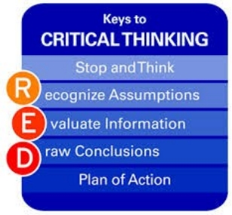
Applying EQ to Address Your Workplace Challenges Critical thinking skills
The word“critical”often misleads us to think that critical thinking is only based on soul-less data, information and evidences.
According to Rudd, Baker and
Hoover (2000), critical thinking
is a “reasoned, purposive and
introspective approach to
solving problems or addressing
questions”.
Introspection when solving problems as a team includes acknowledging the thoughts of others, one of the key elements of emotional intelligence.

Slide 37

Applying EQ to Address Your Workplace Challenges Influencing even when you do not have authority
With authority, you can simply “order” to do what you want. That may not be the most effective leadership strategy; you’ll get what you ask for.
But, how to influence someone over whom we have no control, power or authority?.
➢First, respect other people’s opinions or thoughts.
➢Don't tell people they are wrong. ➢Be more inclusive, less divisive. ➢Be conversational, not argumentative.
➢
Listen more, talk less.

Slide 38

Applying EQ to Address Your Workplace Challenges Influencing even when you do not have authority True influence can be seen in great leaders.
They represent a segment of the population who depends that he or she will stand up for their rights, their beliefs and their needs.
I like how Rick Warren use a
biblical example to explain
influence:
"The purpose of influence
is to 'speak up for those
who have no influence.' It's
not about you. " (proverbs
31:18)

Slide 39

Applying EQ to Address Your Workplace Challenges Supporting the effectiveness and success of your change initiatives
Change management focuses on people, and is about ensuring change is
thoroughly, smoothly and
lastingly implemented
When initiating a change, the first step is to dig down further to define your specific objectives.

Slide 40
Applying EQ to Address Your Workplace Challenges Typically, these will cover :
Sponsorship, - senior level
directly or indirectly
Buy-in, -from those involved and affected
Involvement, -people from
design and implementation Impact, how the changes will affect people.
Communication, -Telling everyone who's affected about the changes
Readiness, - to adapt, ensuring they have the right information, training and help

Slide 41

Applying EQ to Address Your Workplace Challenges Responding to the intense emotions that accompany transition and change.
Keep things in perspective and p ractice the 5 P‘s
-Patience,
-Persistence,
-Practical,
-Positive , and have a
-Purpose.
In addition, keeping an open mind and being curious about the possibilities that change promises, being flexible, staying motivated, and having a sense of humor will buoy your resiliency and help you persevere.

Slide 42

Applying EQ to Address Your Workplace Challenges Responding to the intense emotions that accompany transition and change.
Going through transitions that accompany change can be thriving and also difficult.
Mastering the art of change over the course of a lifetime provides a great advantage to alter your responses to change in order to create a more satisfying
experience.
These are basic 5P’s of things to consider that can help you negotiate and navigate your course to the intense emotion that accompany transition & change.

Slide 43
Transactional Analysis

Slide 44
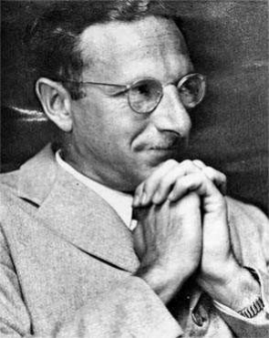
A Sketch of Eric Berne • DoB: May 10, 1910; Place of Birth:
Canada
• Studied Medicine & received M.D. and
C.M (Master of Surgery) - 1935
• Began training as psychoanalyst at NY
Psychoanalytic Institute in 1941
• Army psychiatrist during World War II
• Practiced Group Therapy
•Presented first paper on TA in 1957 - Introduced ego states •Had started testing his theories on TA in the 1950`s itself in
seminars
2

Slide 45
What is Transactional Analysis (TA)? • When two people interact with each other,
they engage in social transactions, in which
one person responds to the other.
• Study of such ”Social Transactions” is
called ’Transactional Analysis’.
• Transactions are Psychological in nature and relate to how people behave and how other people behave with them in response to their behaviour.
3

Slide 46
Transactional analysis
Transactional analysis defined by Eric Berne is a theory of personality and social action and a clinical method of psychotherapy based on the analysis of all possible transaction between two or more people on the basis of specially defined ego states.
4

Slide 47
What is a Transaction?
• A Transaction is an exchange of two strokes between two people. The first stroke is called ’Stimulus’, the second is called the ’Response’.
5

Slide 48
Ego States
Set of consistent and coherent patterns of thinking, feeling and behaving
-Berne
set: each ego state has more than one manifestation consistent & coherent: clear & integrated self-awareness
arising from diagnosis of ego-states
thinking, feeling & behaving : total experiences of an
individual
6

Slide 49

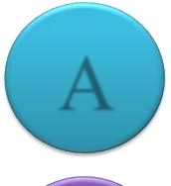

Ego States- PAC Model
• Parent Ego State
P
• Adult Ego State
• Child Ego State
• Later on Parent and child stages have been subdivided into two subgroups
A
• Parent
– Nurturing or Controlling
• Child
C
– Free or Adaptive
7

Slide 50
Parent Ego State
• Set of thoughts, feelings and behaviors learnt or borrowed from parents or other care takers
– Critical Parent – prejudiced thoughts, feelings & behaviors
– Nurturing Parent – Soft, loving and permission giving
8

Slide 51

Parent Ego State
Vocabulary:
Tone:
▪ Should, don’t, must, always, never, now
▪ Sneering, loud, harsh,
contemptuous,
what? Because I said
condescending,
so
punishing,
▪ I’ll take care of you, poor thing, there-there,
▪ sympathetic,
encouraging
come on, give it a try
P
Facial Expression:
Gesture/Posture:
▪ smile encouragingly,
▪ Pointed finger,
▪ set jaw,
▪ shaking head,
▪ outthrust chin,
▪ arms folded on chest, tapping feet/fingers,
▪ raised eyebrows
9

Slide 52

Parent Ego State
Don’t argue!
Don’t worry!
Shame on you!
There there!
P
Be quite!
Let me help you.
That’s really bad.
Everything will be fine!
Don’t you DARE !
Have some fun.
10

Slide 53
Child Ego State
• Seat of emotions, thoughts, memories from childhood • How one responded to early experiences and the
positions one took about oneself & others
• Feelings of happiness, fear ,anxiety, withdrawal etc. • Types:
−Free Child – Spontaneous feeling, playful, authentic, emotional
−Adapted Child – Comply with parental messages
−Rebellious Child – Does not comply with parental
messages
11

Slide 54

Child Ego state
Vocabulary:
▪ Wow, Tone:
▪ give me what I want, ▪ giggle, chuckle, ▪ MINE, whine, swear, yell, ▪ I wish, ▪ fast & high-pitched, ▪ I’m scared, help, whistle, playful,
▪ ask permission.
C
Facial Expression:
▪ tears, pouting,
Gesture/Posture:
downcast or uplifted
▪ slumped,
▪ eyes, tilted head,
▪ curled up,
wide-eyed, fluttering
▪ putting up hand to ask question
▪ eyelashes, flirtatious,
admiring
12

Slide 55
Child Ego State
I don’t wanna !! Pleeeeeeeeaassse!
O! that’s fun!
WOW-WEE!
C
I can’t!
I want……!
No-no-no!
Look how tall my castle is! Yayyyy….!
I don’t care!
13

Slide 56
Adult Ego State
• Oriented towards current reality and objective gathering of information
• No relation with a person’s age
• Data processing center
• Solutions based on facts and not solely on pre- judged thoughts or childlike emotions
14

Slide 57

Adult Ego State
Vocabulary:
Tone:
▪ how, why, when,
clear & calm, confident,
where, what,
factual,
▪ alternatives, results,
enquiring.
yes, no, caused by,
statistics, facts not
opinions.
A
Gesture/Posture:
▪ straight (not stiff),
Facial Expression:
▪ lean forward to
▪ thoughtful, watching
listen/look,
attentively,
▪ relaxed, thinking with
▪ questioning, alert,
hand on chin,
lively
▪ patient.
15

Slide 58

Adult Ego State
Respect.
Assertive.
Aware.
Open
A
Equality
Present
Rational
Objective
Sand looks interesting.
Lets make a castle!
16

Slide 59



Ego States
Acting, thinking, feeling like your
parent
Dealing with current realities,
gathering facts, objectivity
Acting or feeling like u did when u
were child
17

Slide 60

Life Positions
• T.A has four possible life positions:
I am O.K
You are O.K
You are O.K
I am not O.K
I am O.K
You are not O.K
I am not O.K
You are not O.K
18

Slide 61
• "I'm OK; You're OK." This life position is the only healthy attribute or attitude.The adult must be realistic, aware, tolerant and maintain control of the child and the parent. A person with such an orientation feels positive.
• "I'm not OK; You're OK." This life position requires that others sustain one‘s position to feel OK. When one feels weak and unable to do many things others can do, the dominant feeling is "not OK." If an "I'm not OK" attitude prevails, the client runs a risk of being anxious, depressed, and passive.
• "I'm OK; You're not OK." This life position is a self- centered, self-serving position
19

Slide 62
• "I'm not OK; You're not OK." This life position is the most futile and helpless position of the four. There is no way to turn for help; others won't help the client and the client can't help himself.
• Nothing seems worthwhile and everything is futile.
• This is an unhappy state of affairs and, in the extreme, such a person's only recourse may be to withdraw into the utter hopelessness of depression or other emotional disturbances.
20

Slide 63
Levels of Transaction
Transactions between people are seen as having 3 types:
– Complementary – both people are operating from the same ego state
– Crossed – the other person reacts from an unexpected ego state
– Ulterior – two ego states within the same person but one disguises the other
21

Slide 64
Complementary ‘Transactions’
❑
Interactions, responses, actions regarded as appropriate and expected from another person. Parallel communication arrows, communication
❑
continues.
❑
Such transaction in our lives make our relationship with others happy and long lasting
P
P
Example:
#1 What time do you have? #2 I’ve got 11:15.
A
A
C
C
22

Slide 65
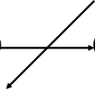
Crossed ‘Transactions’
❑
Interactions, responses, actions NOT regarded as appropriate or expected from another person.
❑
Crossed communication arrows, communication breakdown.
Example 1 #1 What time do you have?
#2 There’s a clock on the wall, why don’t you
figure it out yourself?
P
P
A
A
C
C
23

Slide 66
Ulterior ‘Transactions’
➢
Interactions, responses, actions which are different from those explicitly stated
➢
Involve more than two ego state at same time.
Example#1 How about coming up to my room and
listening to some music?
P
P
A
A
C
C
24

Slide 67
CONCLUSION
Transactional Analysis is a rational and easy to understand method of clarifying and managing human relationships and behaviours and a clinical method of psychotherapy.
25

Slide 68
Thank You…
28

